Slide 1
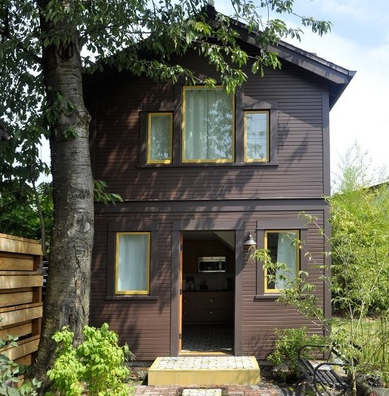
Accessory Dwelling Unit (ADU)
Development Trends
Housing Land Advocates Conference
November 7th, 2014
Jordan Palmeri
Oregon Dept of Environmental Quality
palmeri.jordan@deq.state.or.us
More details: http://www.deq.state.or.us/lq/sw/wasteprevention/greenbuilding.htm
Notes:
Research Credit:
Martin Brown
PSU
City of Portland
Metro
AccessoryDwellings.org

Slide 2
Overview
What’s an accessory dwelling unit (ADU)?
Why does Oregon DEQ like them?
Development trends
Occupancy stats
Do they provide affordable housing?
ADU potential

Slide 3
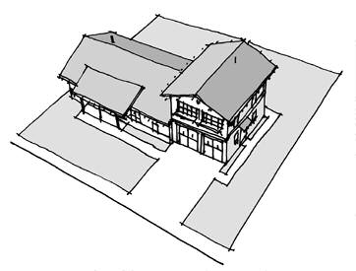
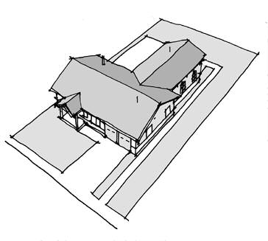
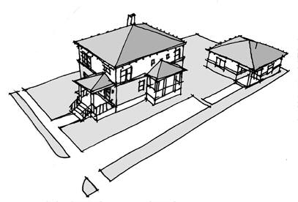
What’s an Accessory Dwelling Unit (ADU)?
An accessory dwelling unit (ADU) is a second dwelling unit on a single family residential lot. They’re also called granny flats, mother-in-law suites, in-law suites, etc.

Slide 4
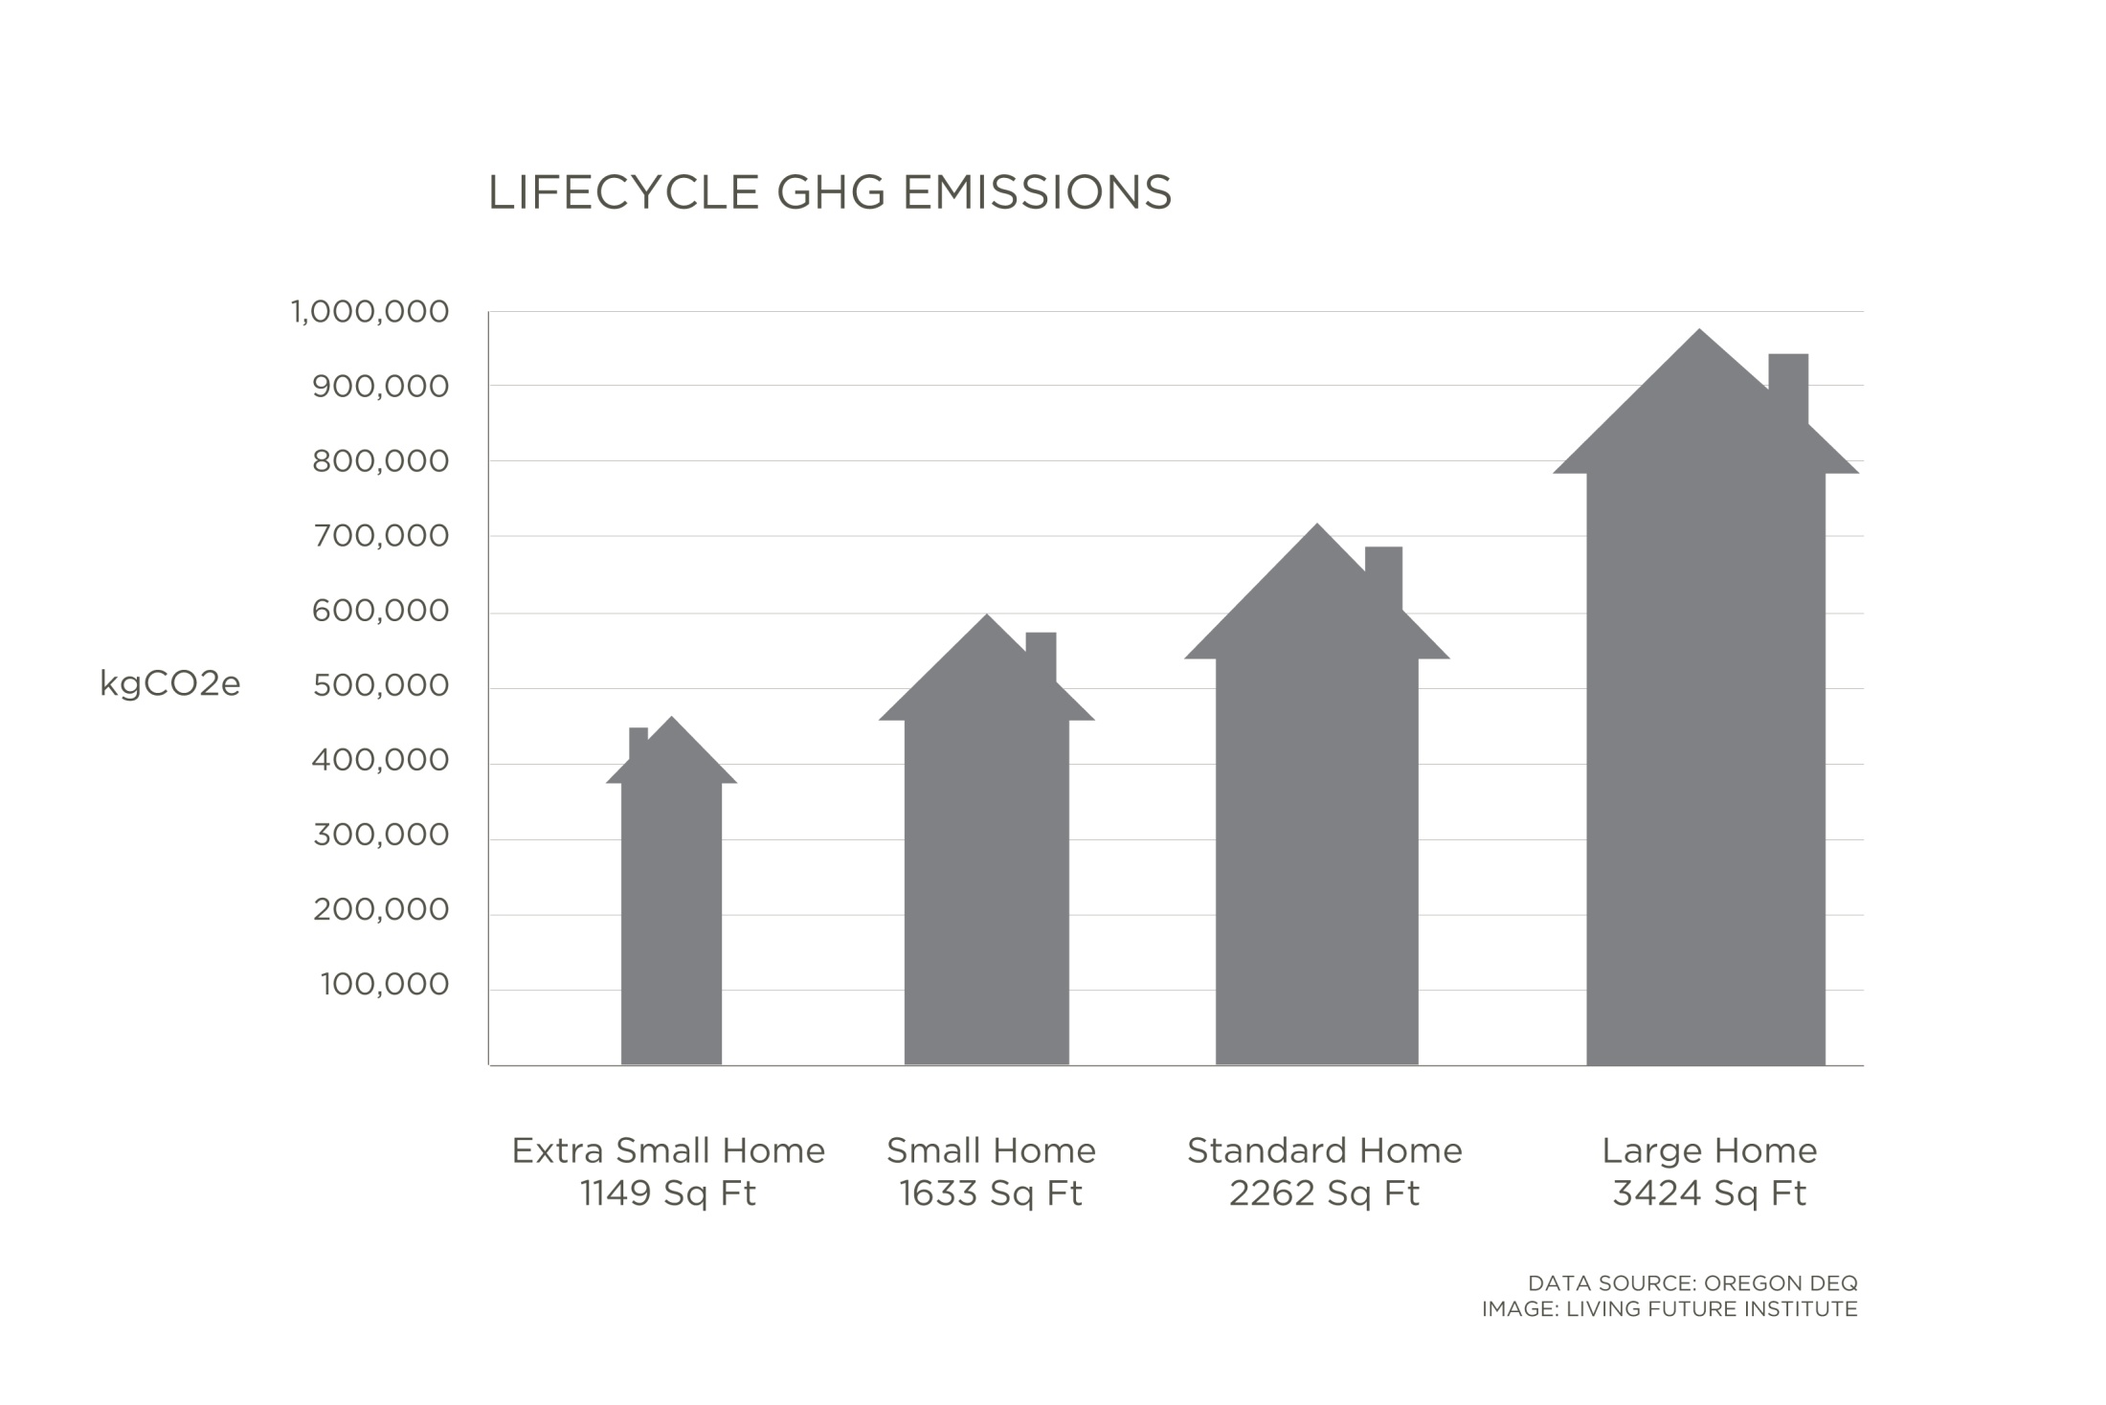
Why does Oregon DEQ like them?

Slide 5
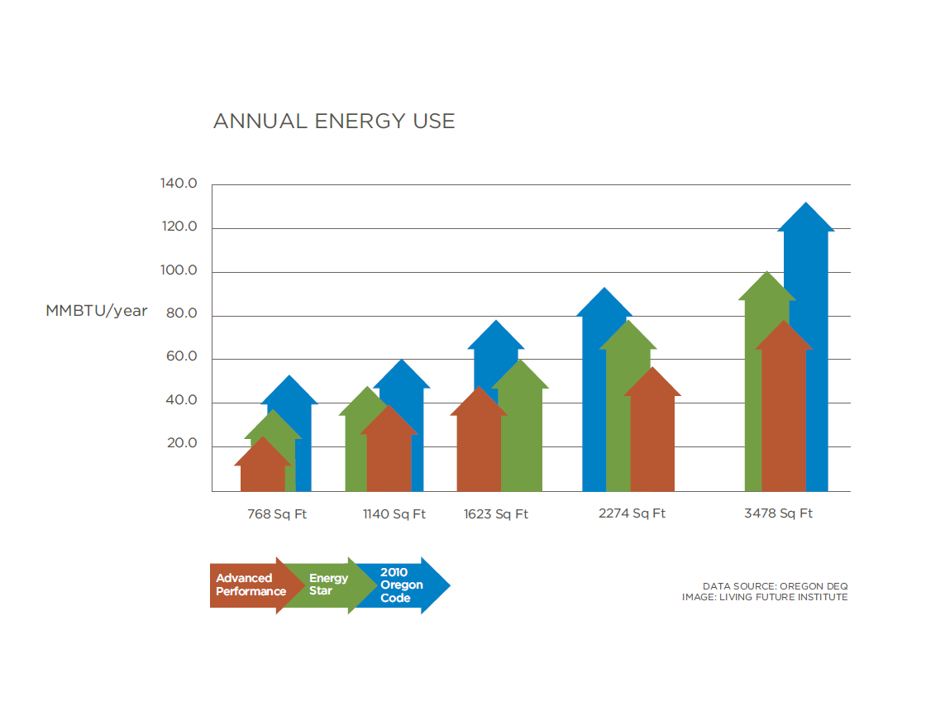
Building Small is a green building strategy

Slide 6
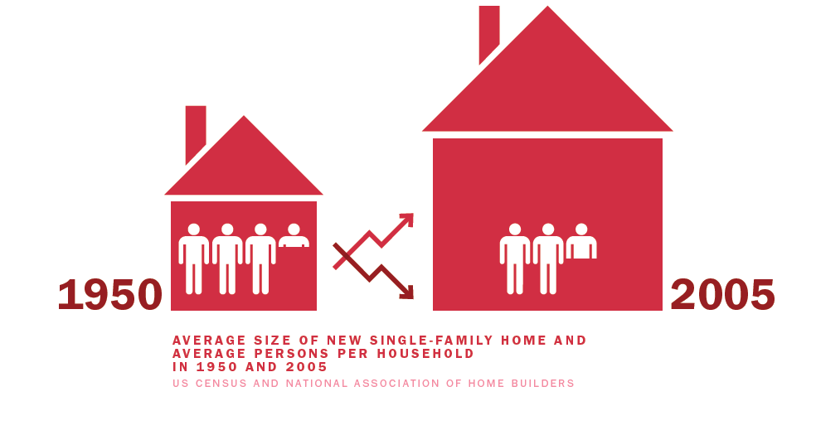
House size has increased

Slide 7
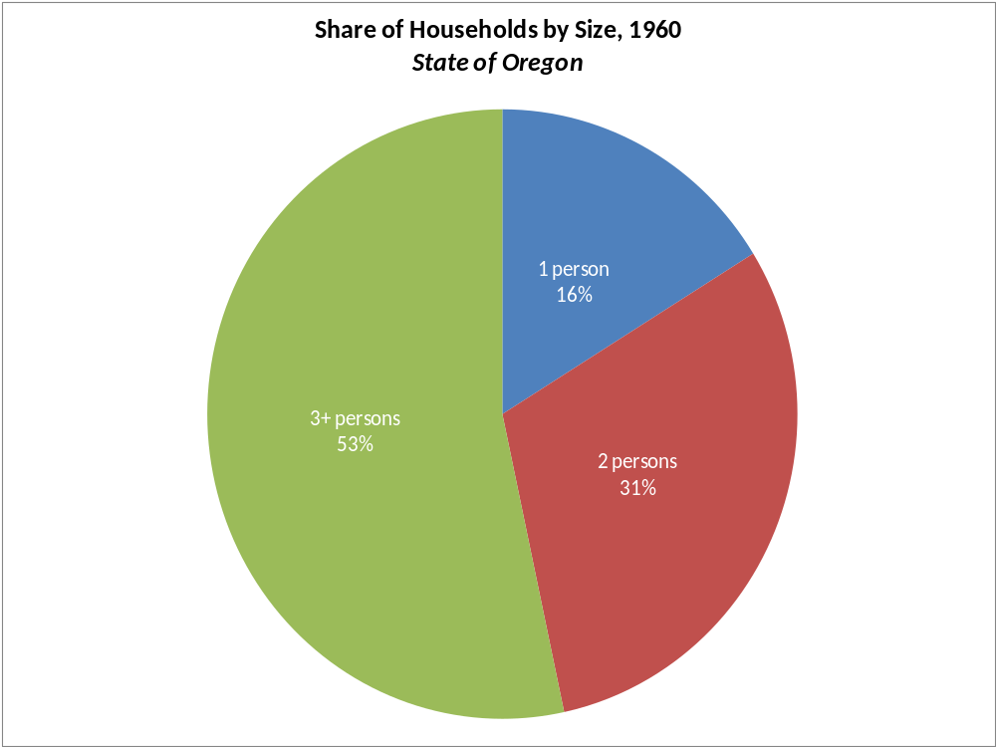
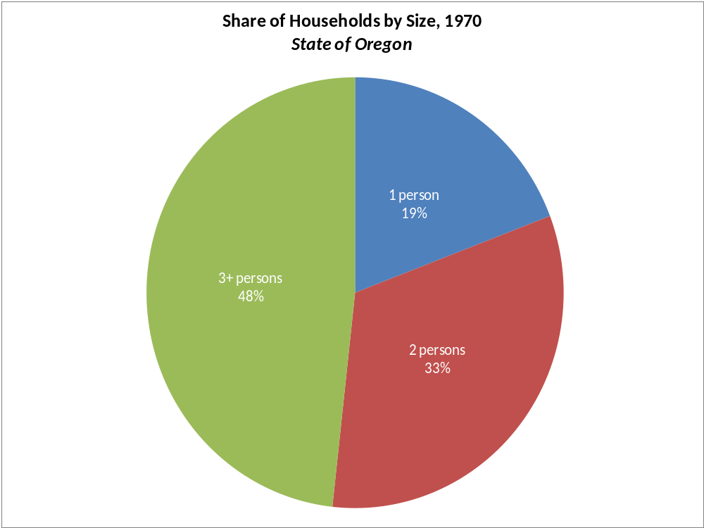
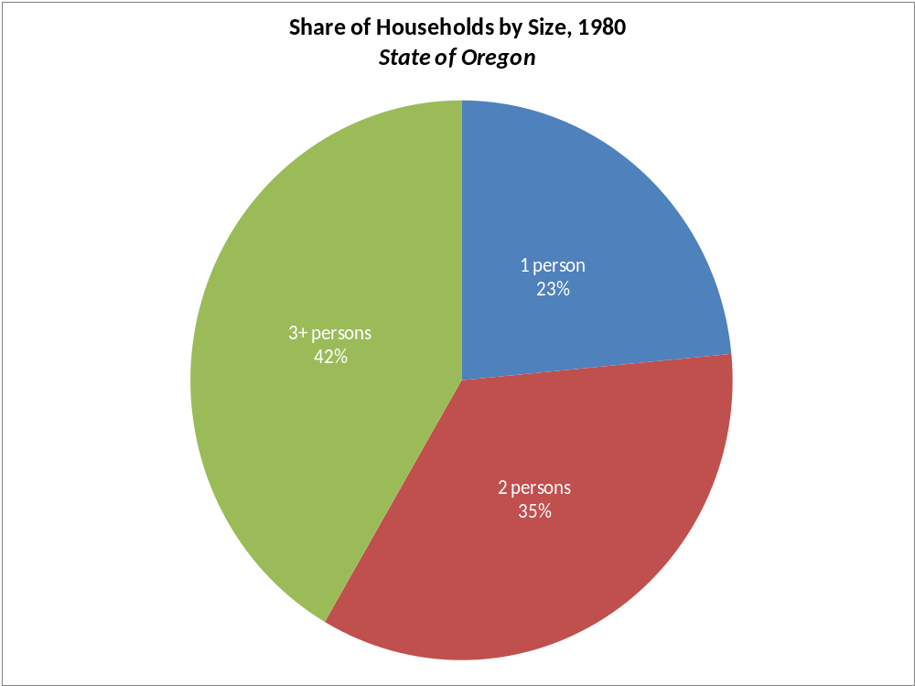
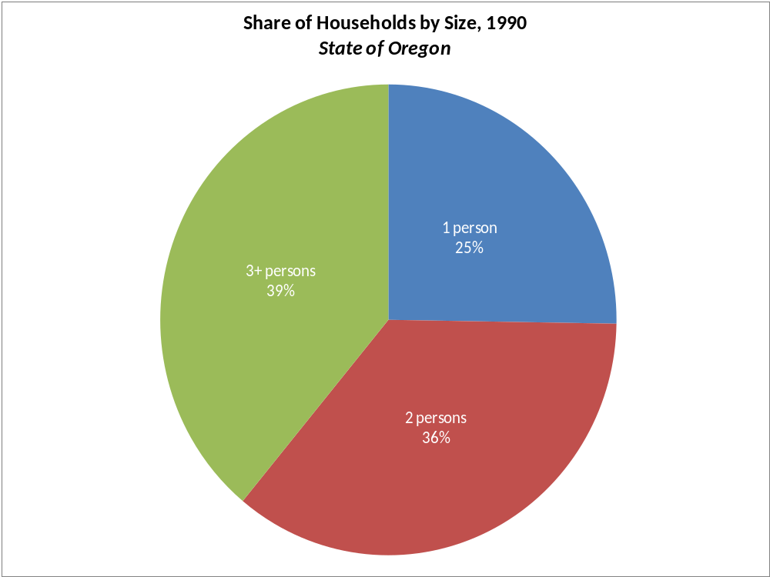

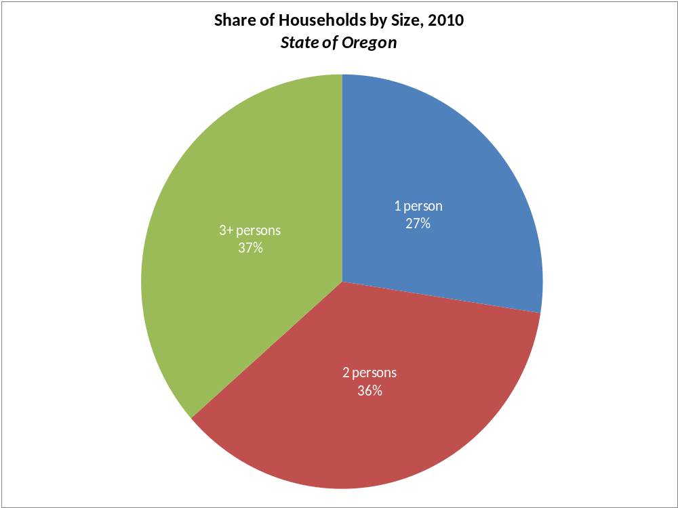

Slide 8
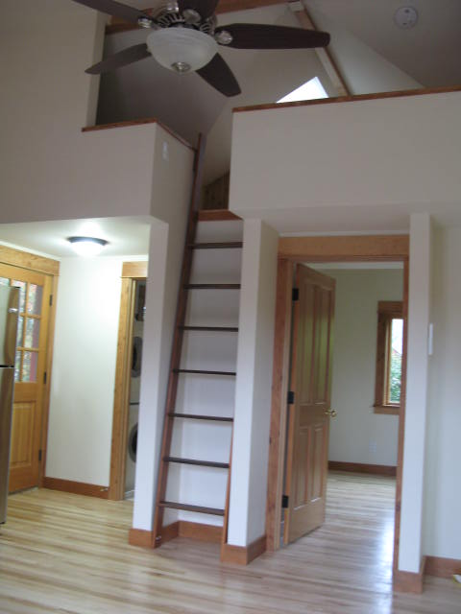
Why focus on ADUs?
Mismatch between household size and house size (consumption patterns)
Single family construction has largest sqft/person ratios
  64% of Oregon population in single family detached
  Good way to introducing smaller SF housing to market
Multifamily already small
Most ADUs are urban infill that utilize existing infrastructure
Nice package that had potential environmental, social, and economic benefits
Wanted to leverage other momentum in ADU industry

Slide 9
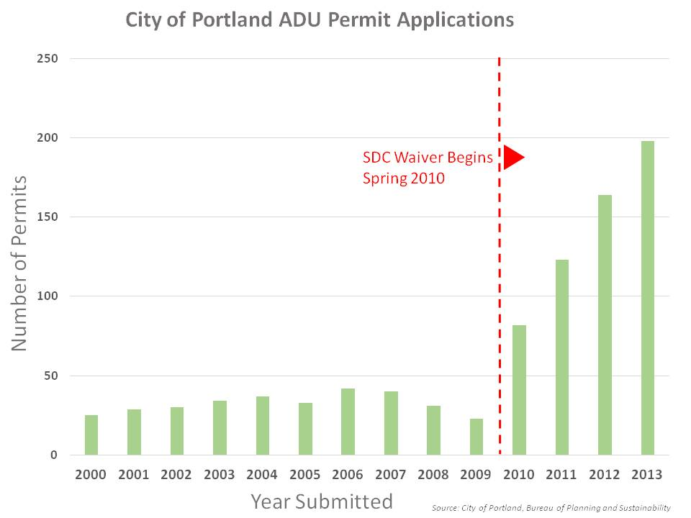
ADU permits in Portland, OR

Slide 10
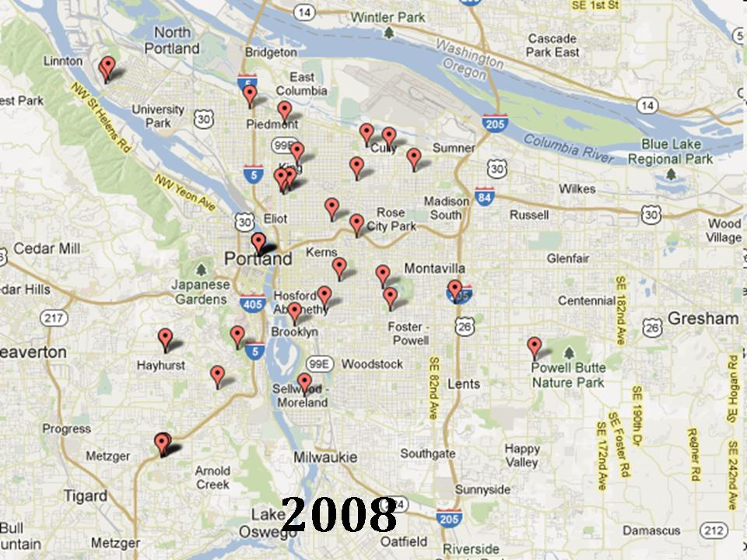
Where are ADUs being built?

Slide 11
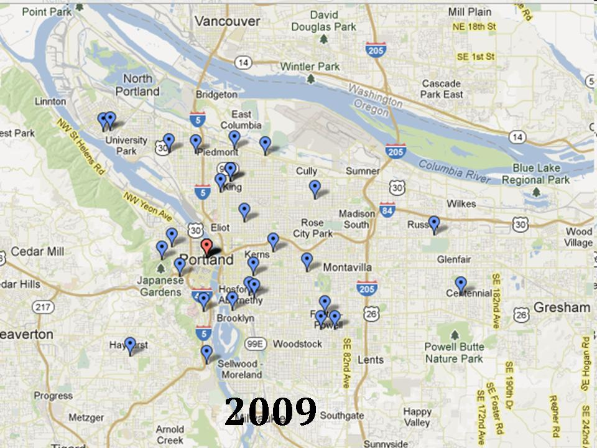
Where are ADUs being built?

Slide 12
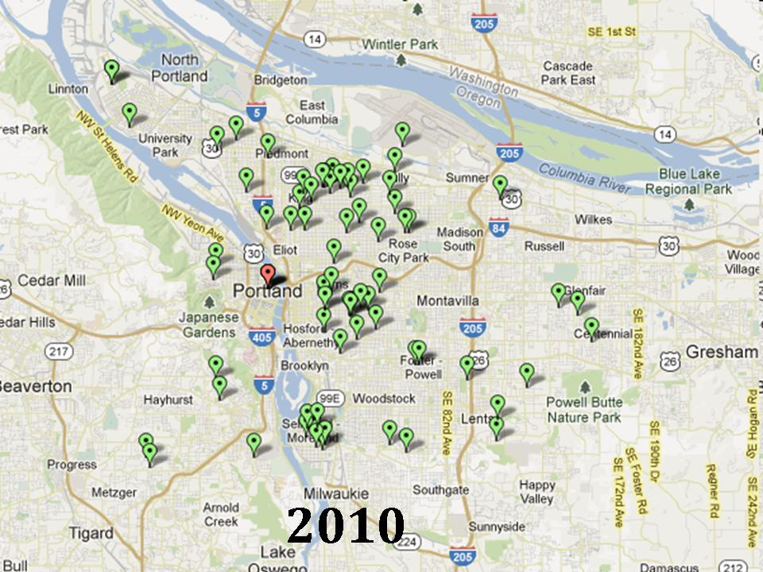
Where are ADUs being built?

Slide 13
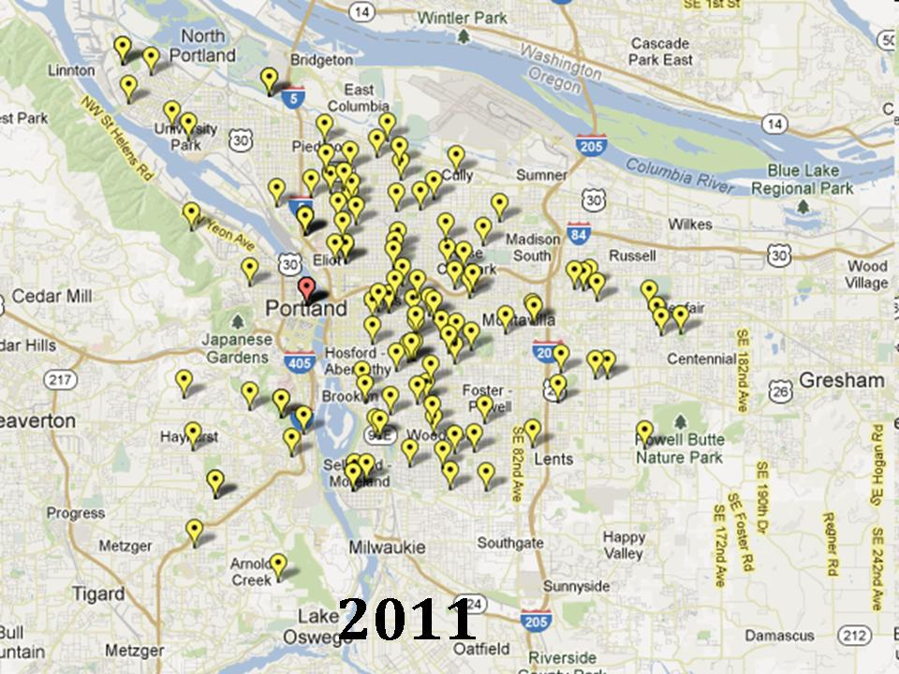
Where are ADUs being built?

Slide 14
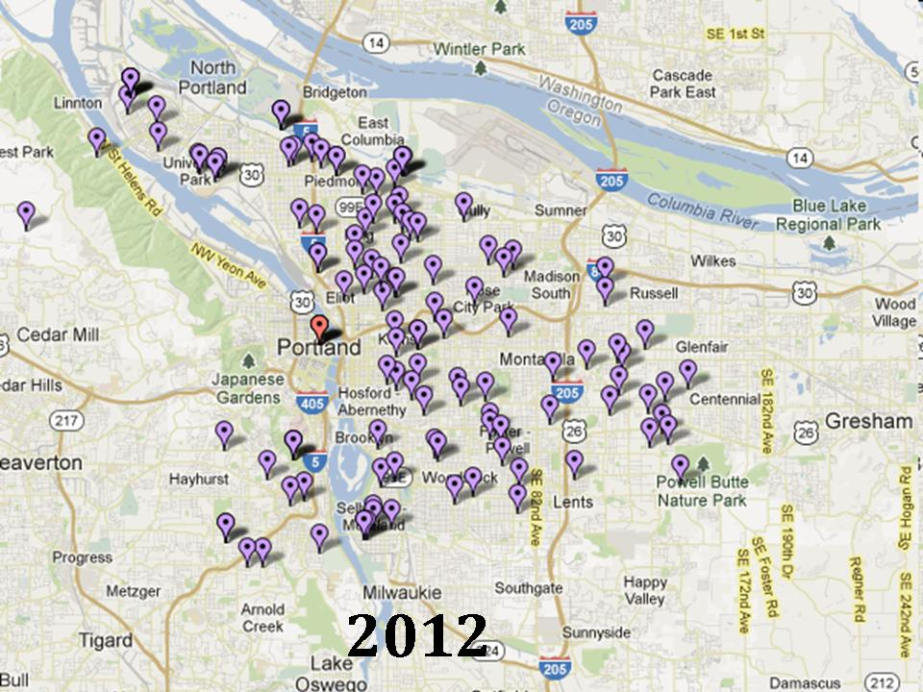
Where are ADUs being built?

Slide 15
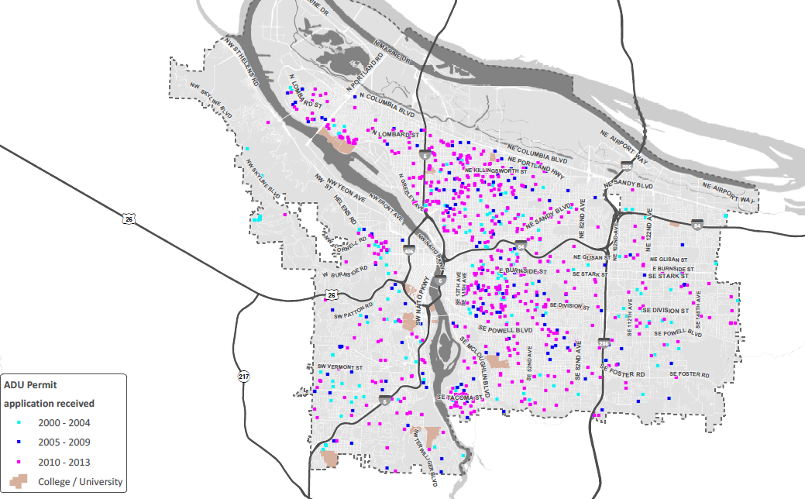
Where are ADUs being built?

Slide 16
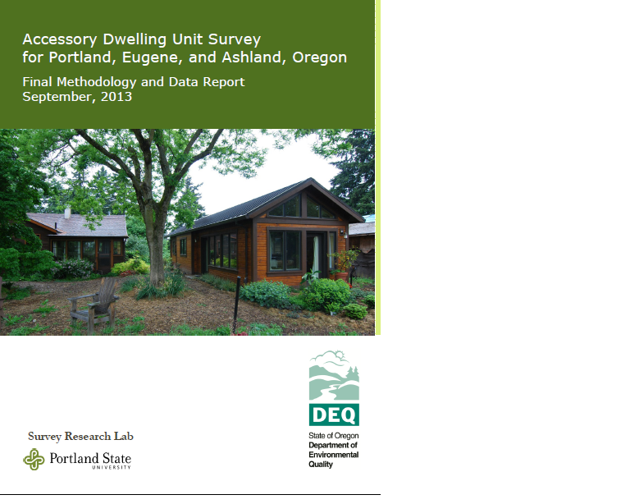
Survey Research of ADU owners
Table 2: Final Response Rates
 | Target Completes | Total Completes | Valid Sample | Response Rate
Portland | 248 | 290 | 673 | 43.2%
Eugene | 82 | 49 | 91 | 53.8%
Ashland | 57 | 30 | 66 | 45.5%
Total |  | 369 | 830 | 44.6%

Slide 17
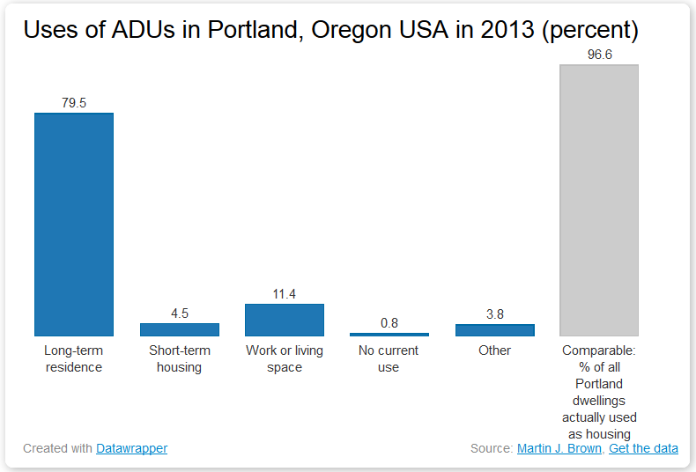
Are ADUs providing housing?

Slide 18
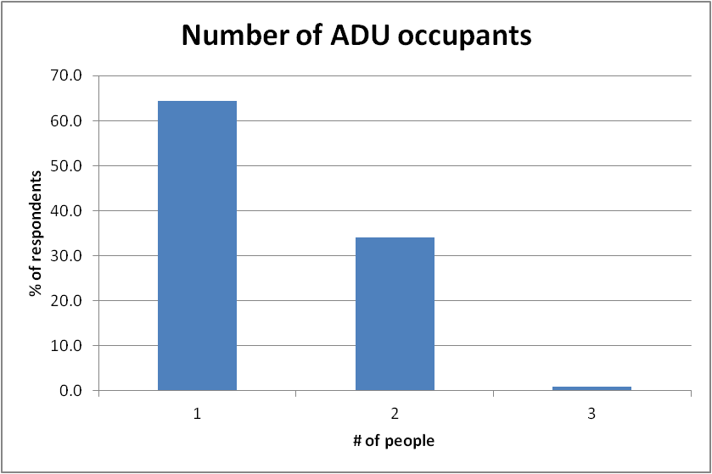
Household Size
Average ADU household size = 1.45 people
Notes:
Could use improvement

Slide 19
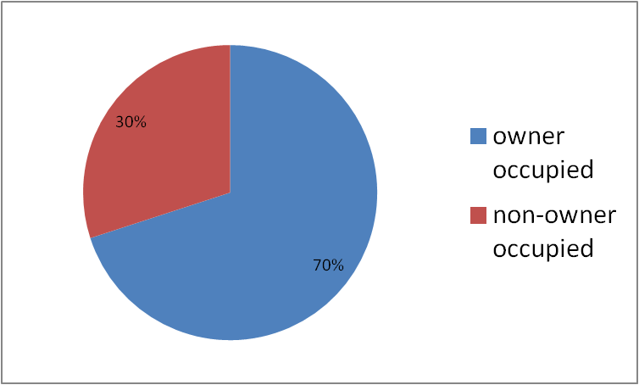
ADU owner status?

Slide 20
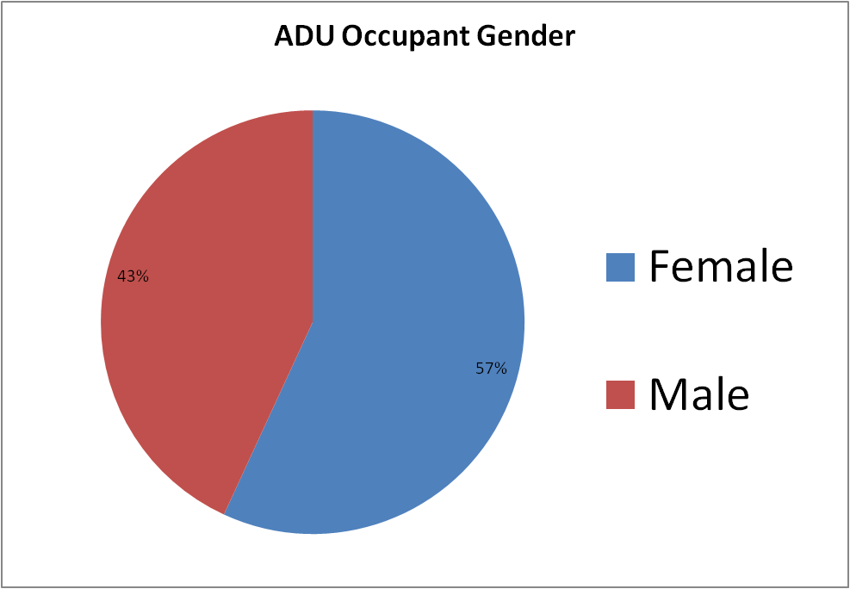
Who lives in ADUs?

Slide 21
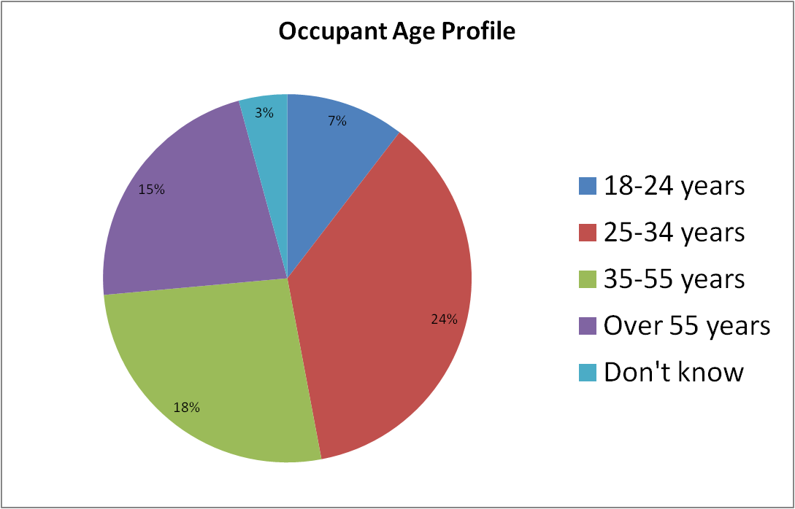
Who lives in ADUs?

Slide 22
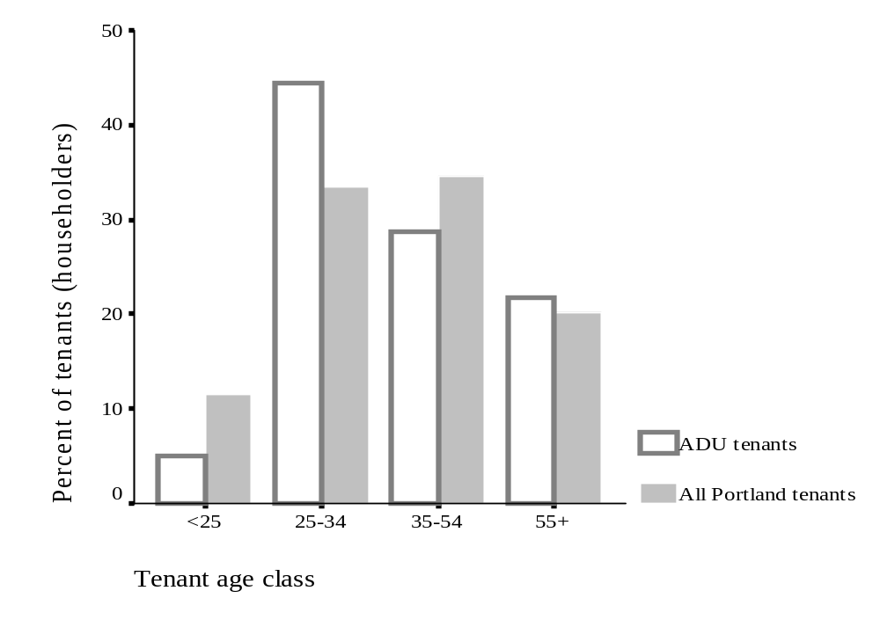
Who lives in ADUs?

Slide 23
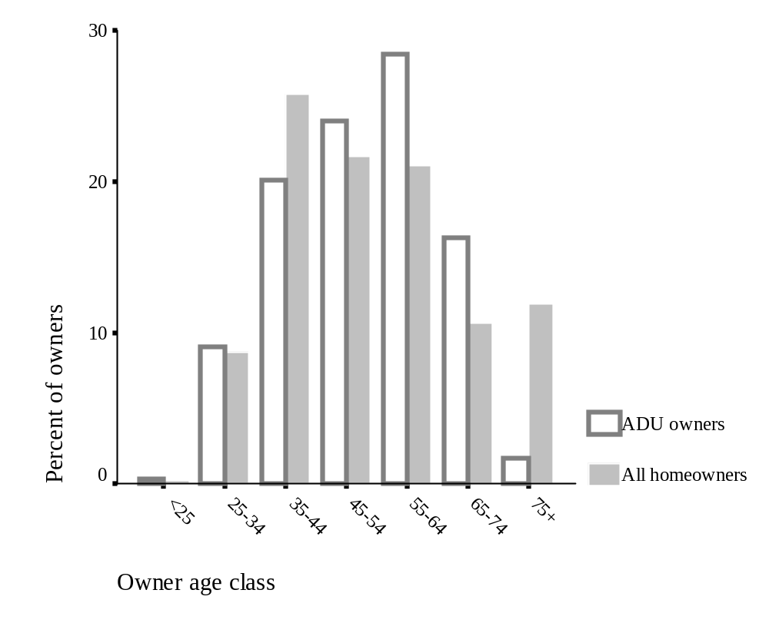
Who owns Portland ADUs?

Slide 24
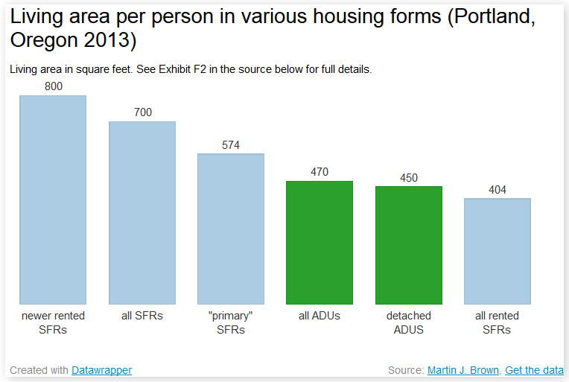
Do ADUs have low environmental impact?

Slide 25
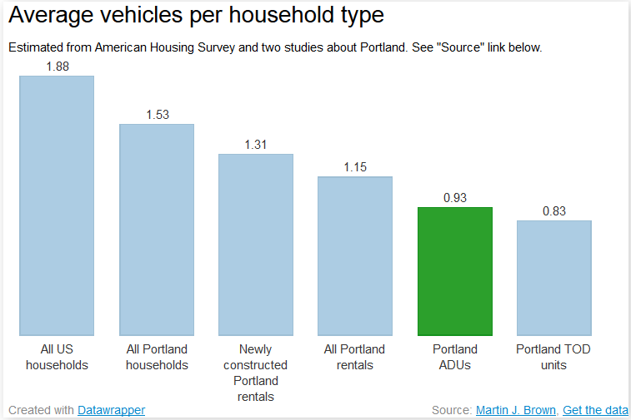
Do ADUs cause parking problems?
Each ADU contributes 0.46 street parked cars

Slide 26
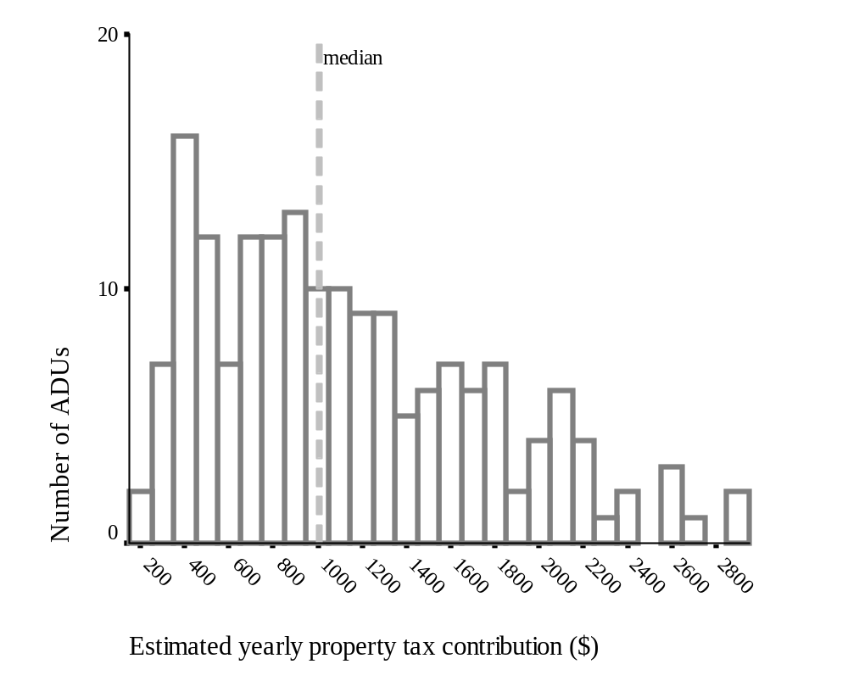
Do ADUs support the community economically?
Average property tax increase of $1134 per property

Slide 27
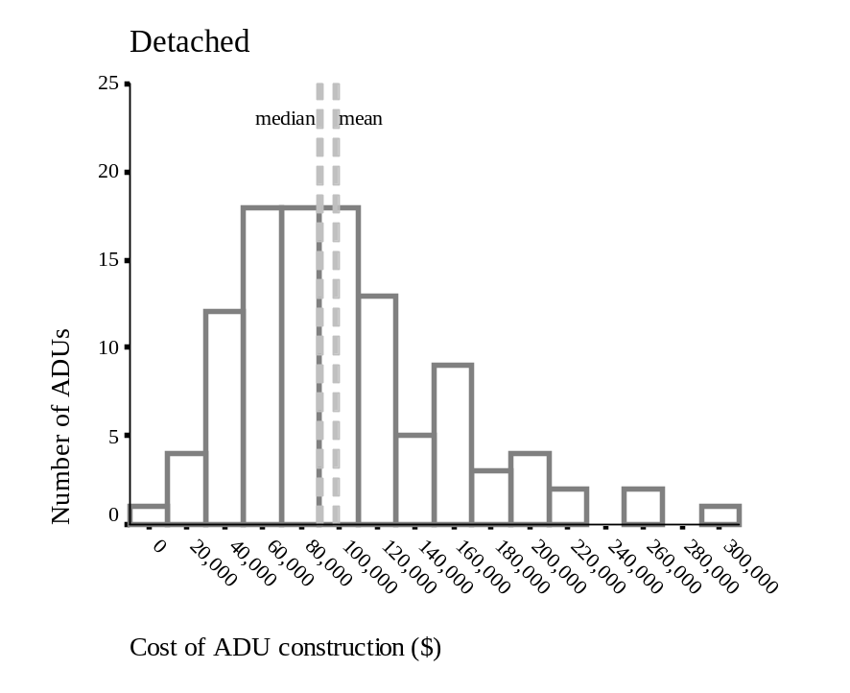
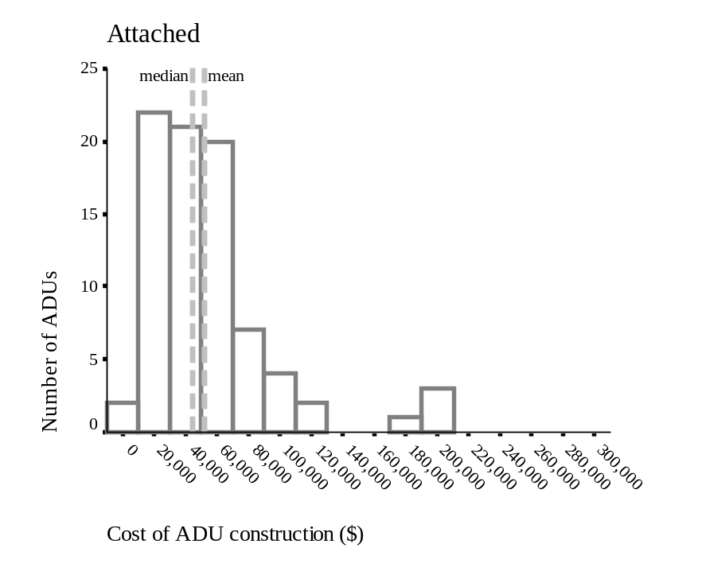
Cost of ADU construction
Detached ADU
- Average cost $100,000
Attached ADU
- Average cost $50,000

Slide 28
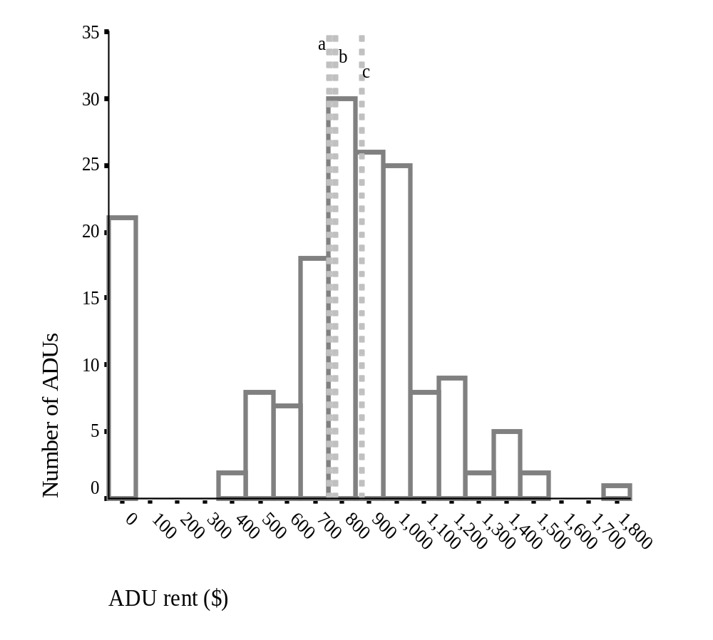
Rental rates
ADU avg $756/month (with $0 rents)
Comparable multi-family rent avg 778sqft/month
ADU avg $872/month (w/o $0 rents)

Slide 29
Do ADUs provide affordable housing?
Occupant
13% of ADU occupants are charged $0 in rent
5% of ADU occupants are charged<$500/month
18% of ADUs provide affordable housing
85% of these tenants are family or friends of the ADU owner
48% of ADU owners are between 55 and 74 years old. The ADU will make their housing more affordable into retirement.
Owner
Developer
Average cost of new ADU is $78,000. How does this compare to the cost of a new affordable housing unit?

Slide 30
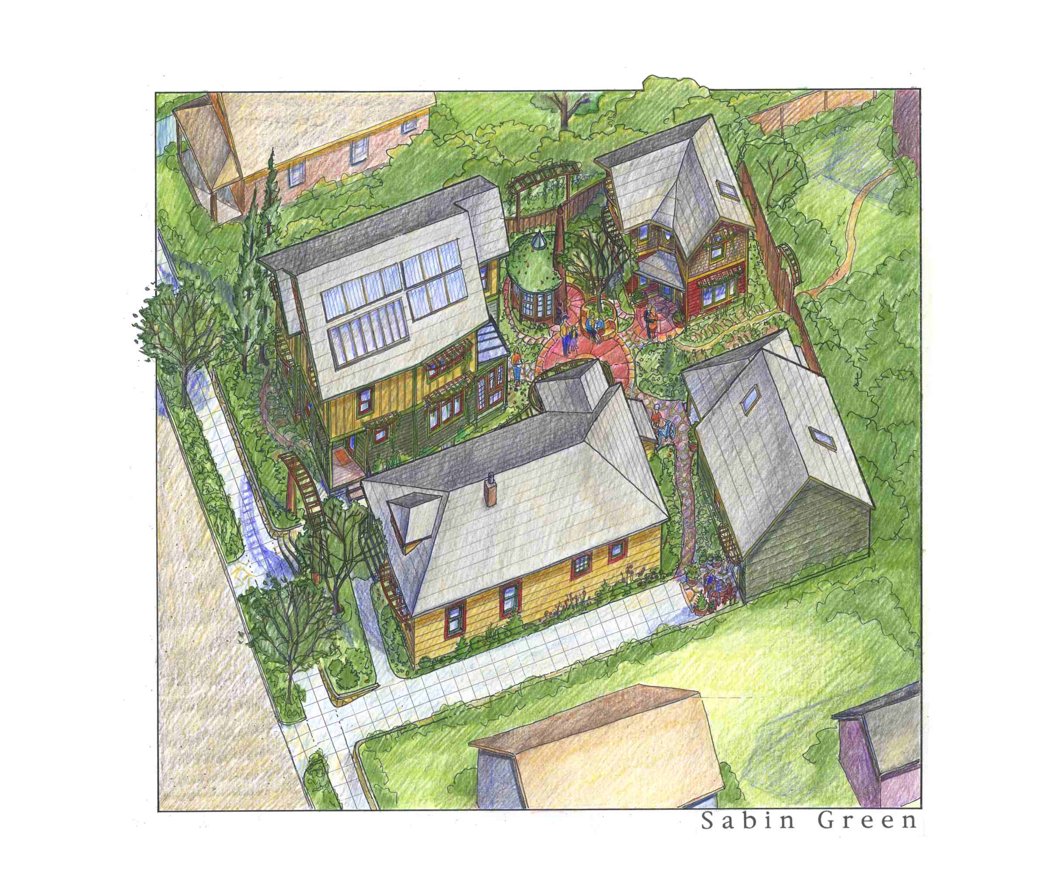
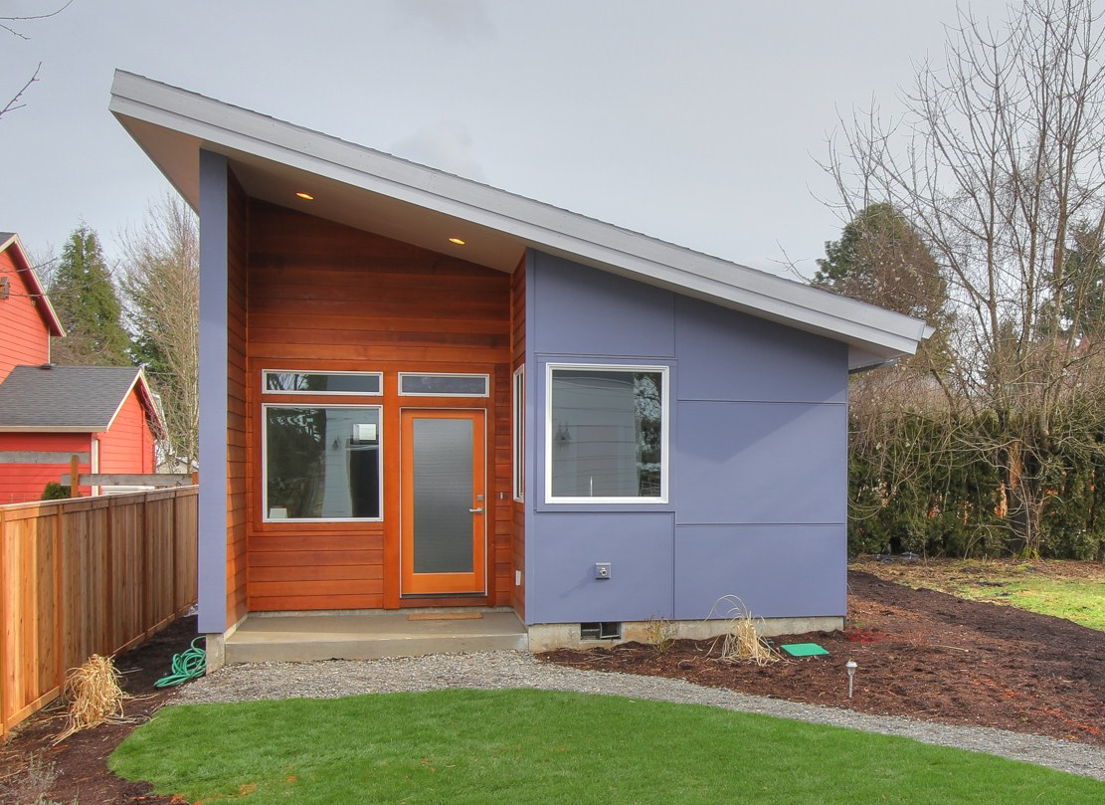
Future ADU trend?
Separating ownership to create affordable starter homes?
Sabin Green
Woodstock Gardens

Slide 31
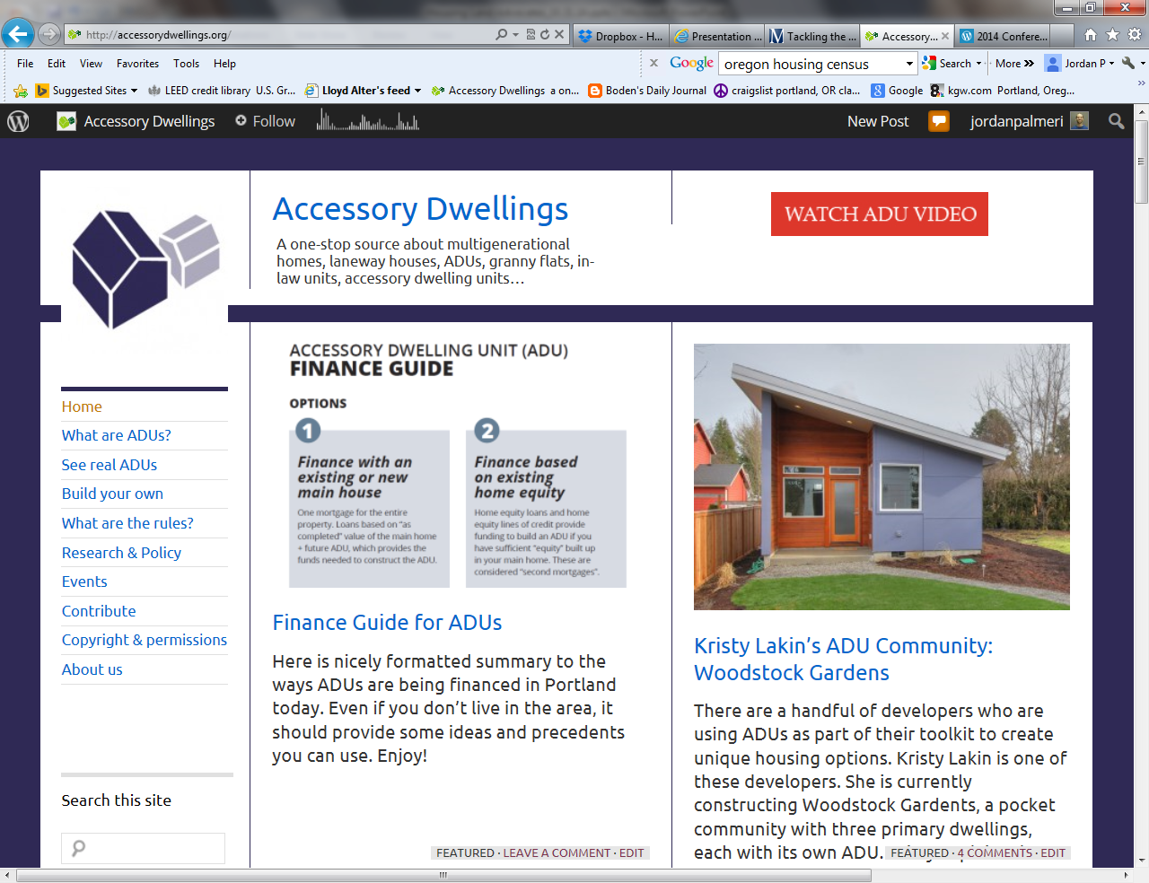
Accessorydwellings.org
Includes:
Case studies
Videos
Tour info
Zoning code
Appraisal guide
Financing guide
Research
Accessorydwellings.org

Slide 32
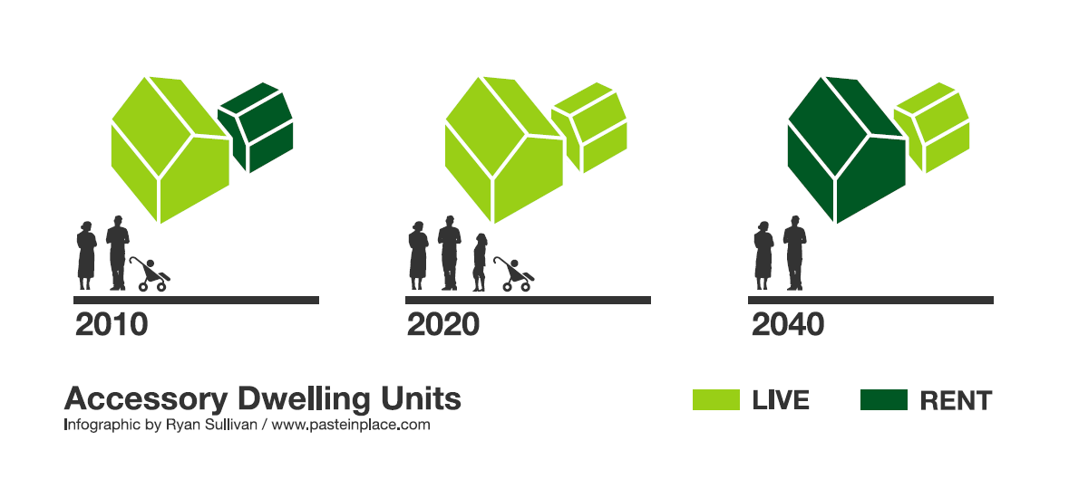
Accessory Dwelling Unit (ADU) Potential

Slide 33

Thank You!
Jordan Palmeri
  Oregon DEQ
  503-229-6766
  palmeri.jordan@deq.state.or.us
  http://www.deq.state.or.us/lq/sw/wasteprevention/greenbuilding.htm

